Slide 1
Welcome to CGT 575 Data Visualization Tools & Applications 2023 spring
Week 11- Lecture 1

Slide 2
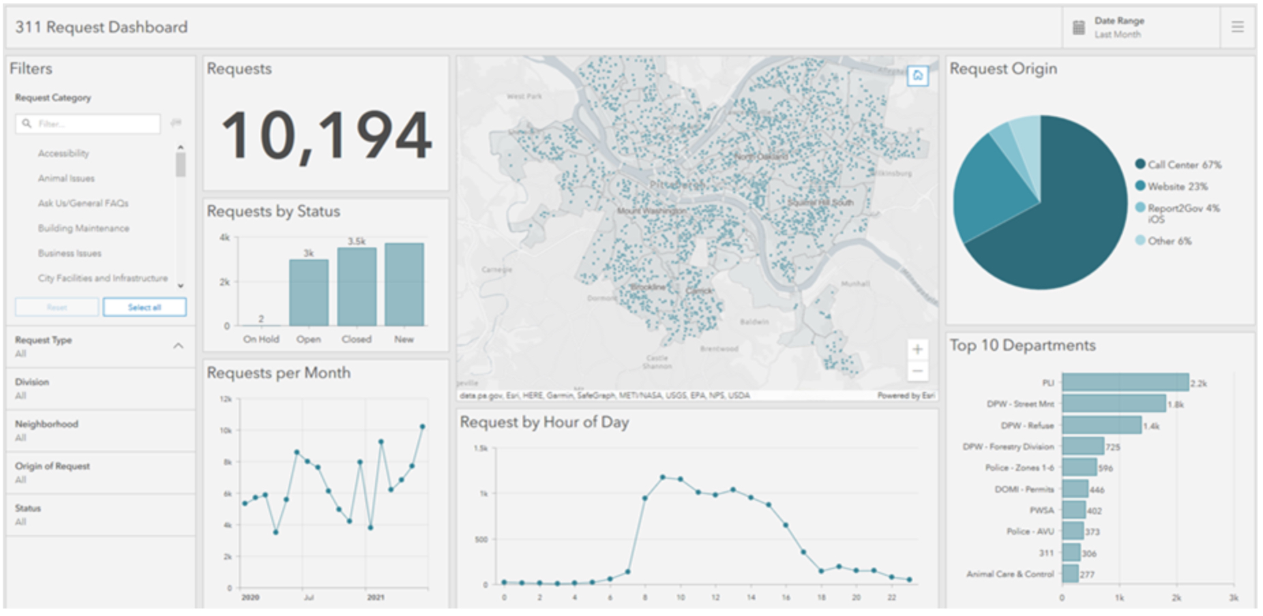
ArcGIS Dashboards?
ArcGIS dashboards is a view of geographic information and data that allows you to monitor events, make decisions, inform others, and see trends.
Dashboards are great for visualizing and breaking down large datasets.
Source: ESRI

Slide 3
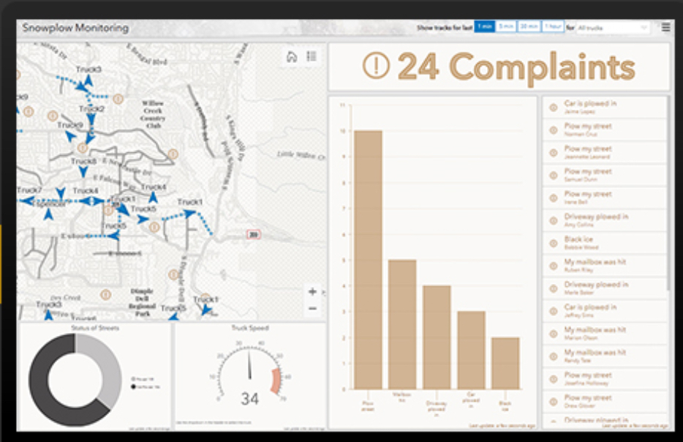
Why ArcGIS Dashboards?
Easy to understand
All relevant information presented on a single screen, facilitating understanding quickly and easily.
Source: ESRI

Slide 4
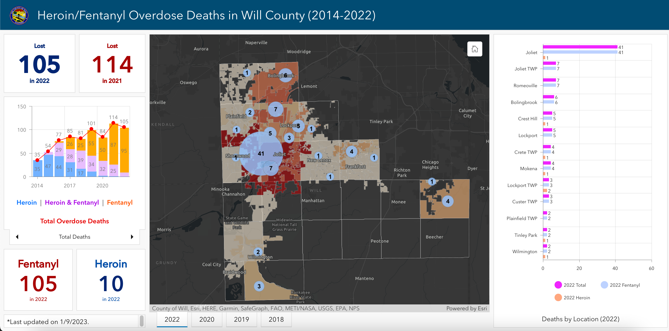
Why ArcGIS Dashboards?
Ready to Use
Comes with a robust suite of data visualization tools, including maps, lists, charts, and gauges, that are ready to use.
Source: ESRI

Slide 5
Why ArcGIS Dashboards?
Interactive
Audience can answer questions and solve problems by giving users a tool they can interact with.
Source: ESRI

Slide 6
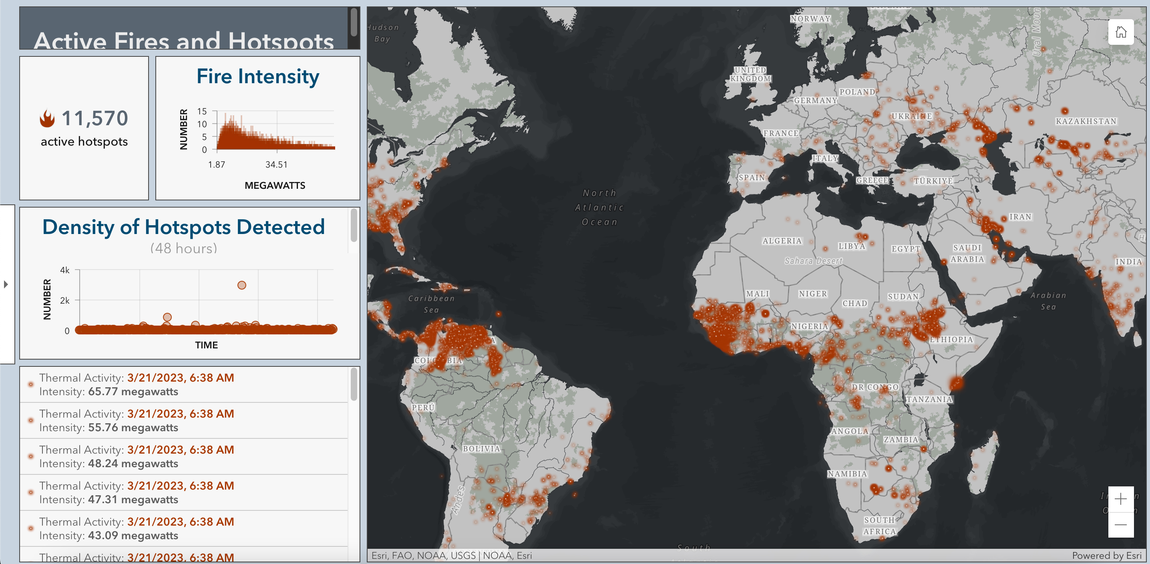
Why ArcGIS Dashboards?
Flexible
Build a dashboard that fits your needs and takes advantage of the data you have.
Source: ESRI

Slide 7
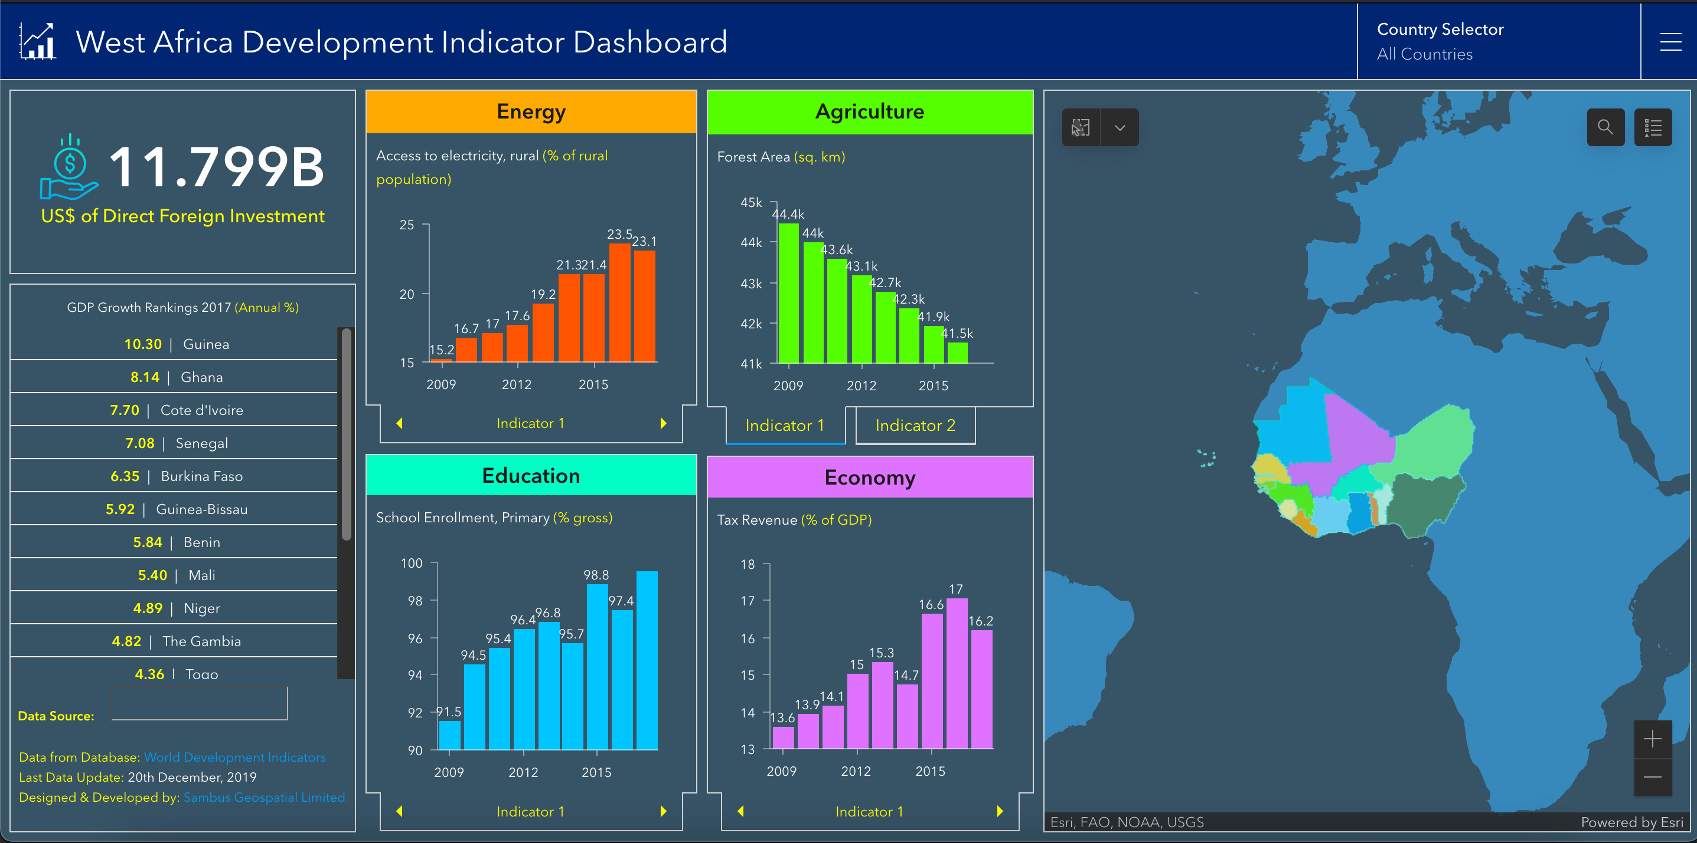
Why ArcGIS Dashboards?
Configurable
Adapt dashboards to specific audiences, events, and situations.
Source: ESRI

Slide 8
Types of Dashboards

Slide 9
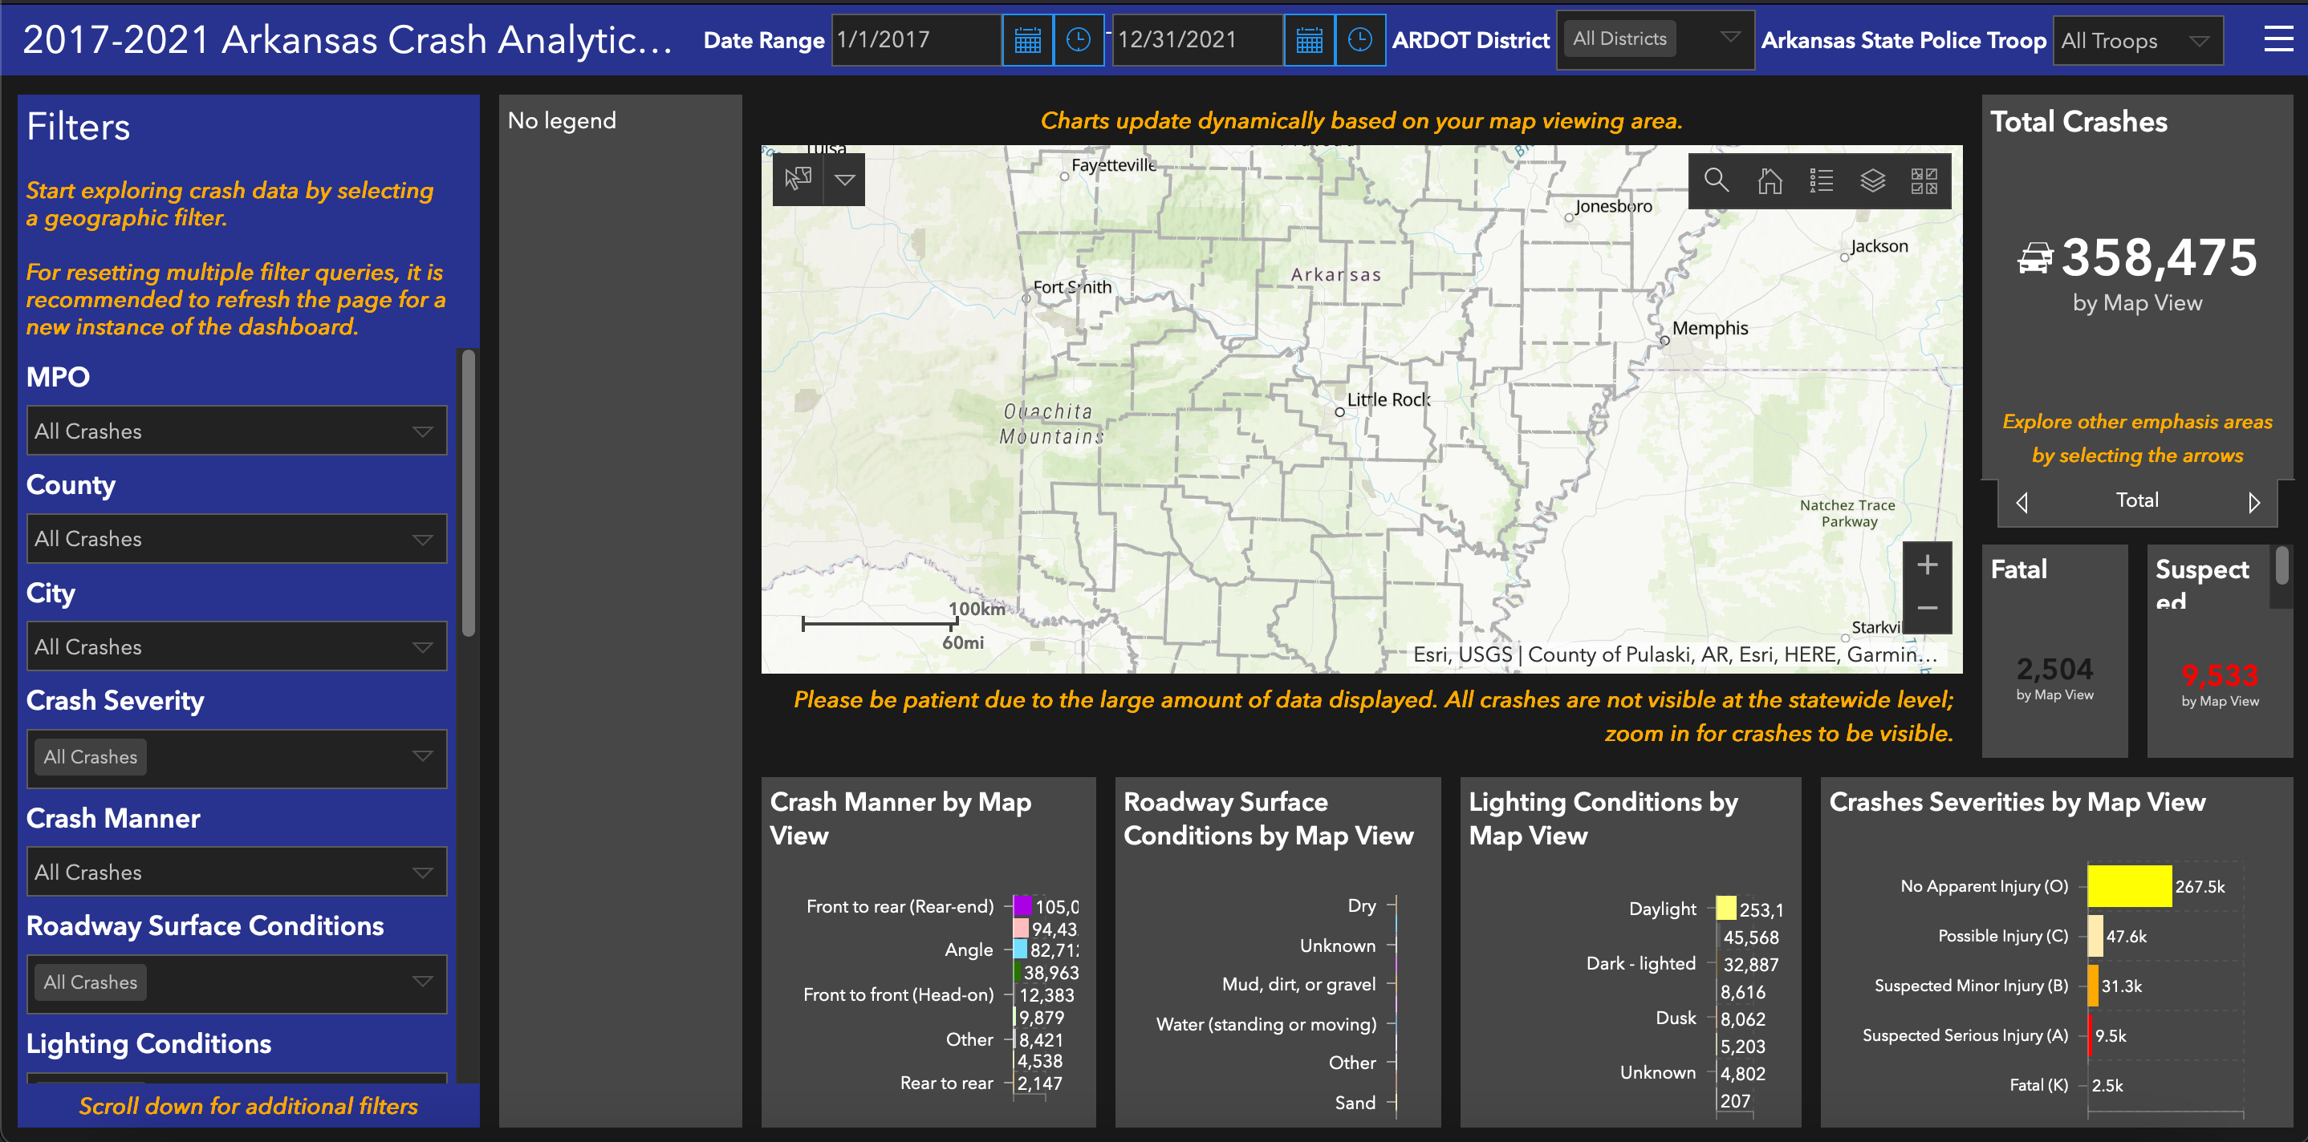
Types of Dashboards-Strategic
Track key performance indicators (KPIs) and make strategic decisions by evaluating performance based on their organization's goals
Source: ESRI

Slide 10
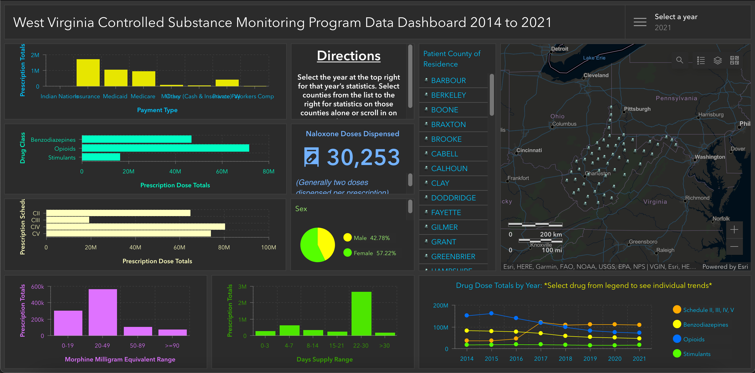
Types of Dashboards-Tactical
Help analyze historical data and visualize trends to gain deeper understanding
Source: ESRI

Slide 11
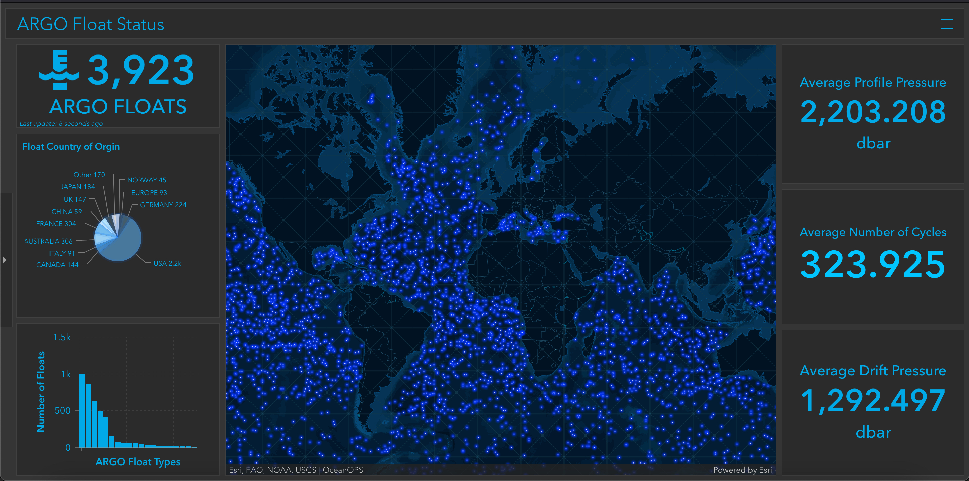
Types of Dashboards-Operational
Help understand events, projects, or assets by monitoring their status in real time
Source: ESRI

Slide 12
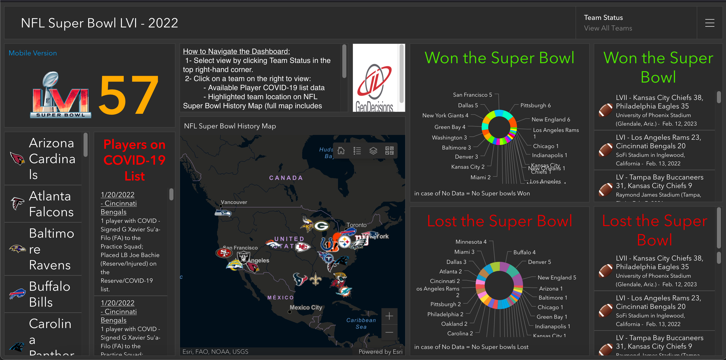
Types of Dashboards-Informational
Help organizations inform and engage their audiences through community outreach.
Source: ESRI

Slide 13
Characteristics of an Effective Dashboard

Slide 14
Keywords- 1) attention, 2) data, important, 3) understand, 4) performance measures, clearly, accurately, directly, without distraction

Slide 15
Dashboard Characteristics
Draws your attention to where it's needed
Shows what's most important on a screen full of data
Provides its audience the ability to understand what's happening and respond quickly
Expresses performance measures clearly, accurately, directly, and without distraction
Source: ESRI

Slide 16
Dashboard Layout

Slide 17
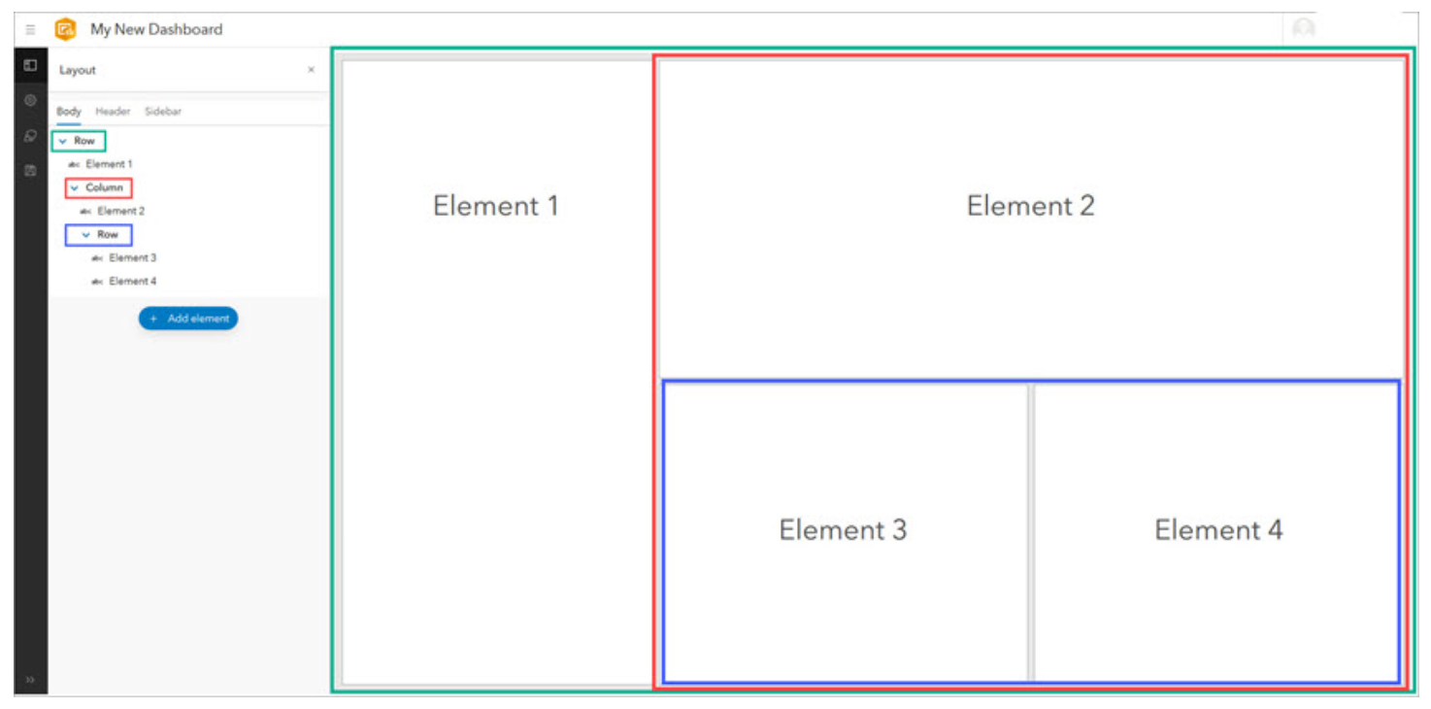
Dashboard Layout
A dashboard comprise of one or more elements- header, maps, lists, charts, gauges, etc.
The layout tree outlines the rows and columns that make up your dashboard
A row describes elements that are docked side by side in the dashboard layout.
A column describes elements that are docked above and below each other in the dashboard layout.
Source: ESRI

Slide 18
Building an Interactive Dashboard-Demo Help drivers locate electric vehicle charging stations that are relevant to their location and needs. Author: Noora Golabi Source: https://learn.arcgis.com/en/projects/build-an-interactive-dashboard/

Slide 19
build an interactive dashboard that allows users to find charging stations for electric vehicles in Canada.
Problem statement
when it comes to finding charging stations, you don't need to see every location, only the ones that are relevant to your location and your vehicle.
you'll configure the dashboard so users can filter the data to the province, city, and connector type that they need.

Slide 20
Configure a webapp and use it to create a dashboard.- Configure pop-ups and create a dashboard.
Outline of steps
Configure dashboard information elements.- Create a title, indicator, table, and details element.
Configure dashboard selectors.- Allow users to filter the dashboard by province, city, and connector type.
Configure actions.- Make the dashboard interactive by connecting elements.

Slide 21
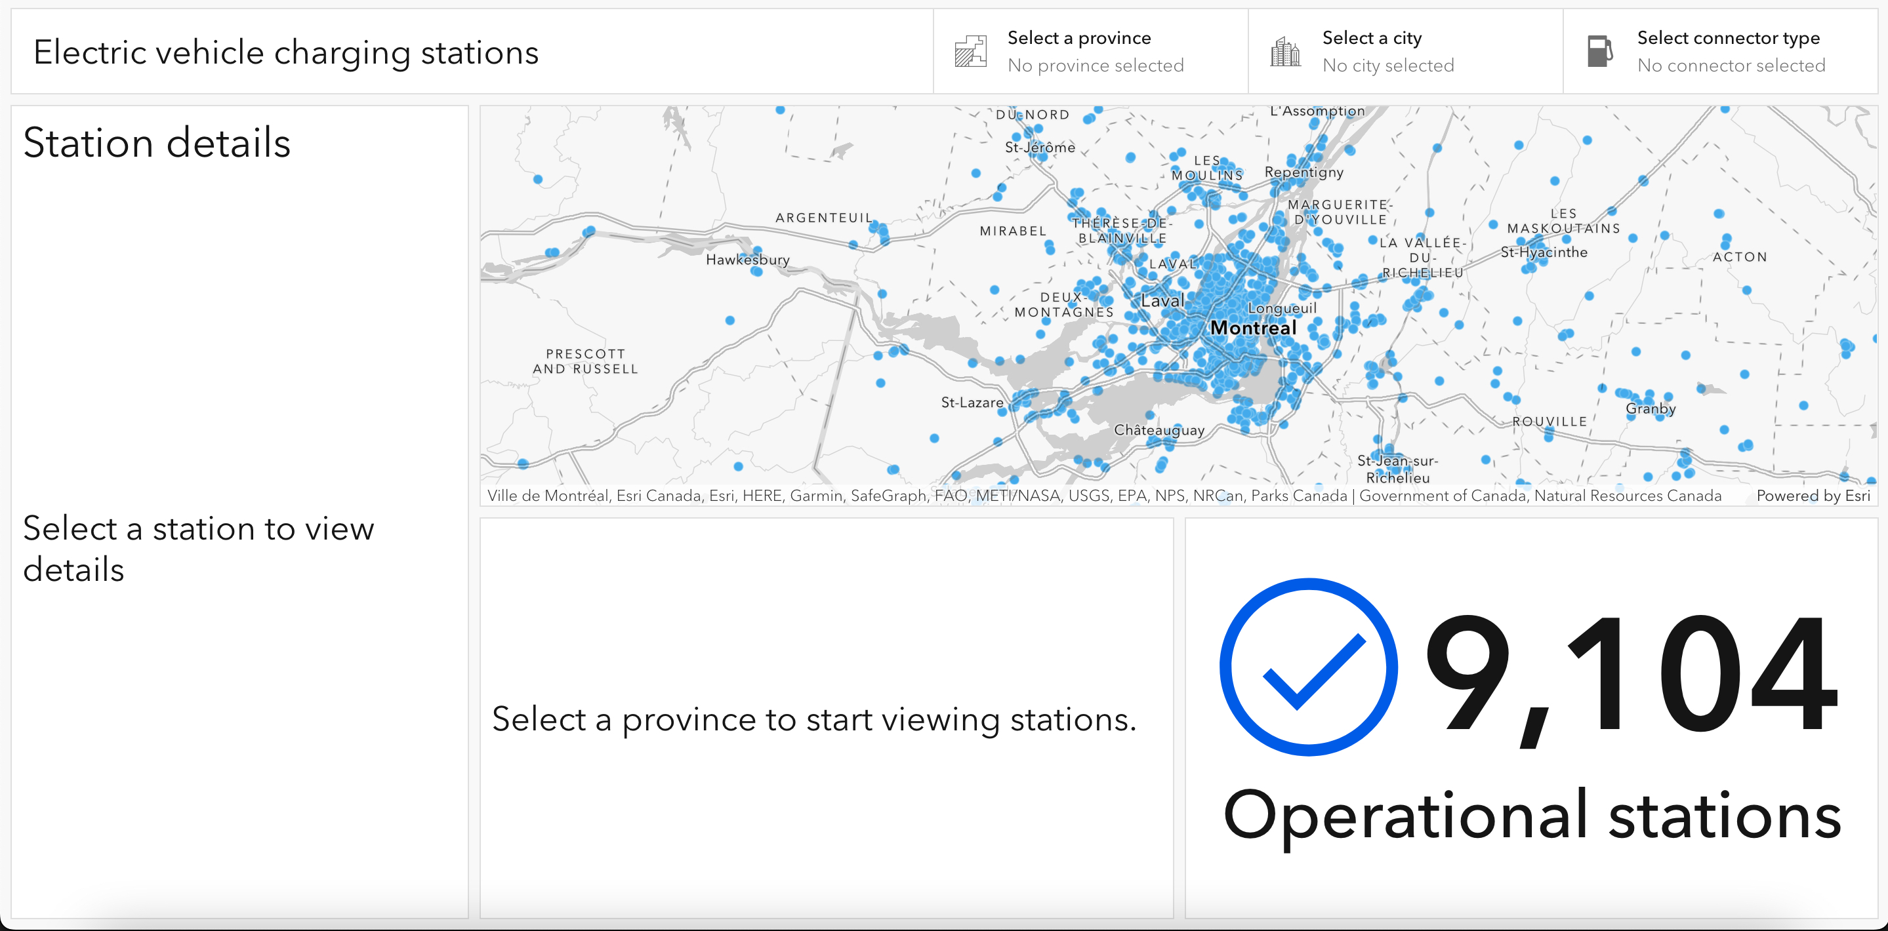
Electric Charging Stations in Canada
Open a webapp
Header (1)
Webapp
Details element (4)
Details element (5)
Indicator (2)
Table (3)
Configure pop-ups

Slide 22
Thank You

